Slide 1
All-Staff Town Hall COVID-19 Preparation
ADD DATE

Slide 2
All-Staff Town Hall COVID-19 Preparation
Your safety means everything to our success!
Your Logo

Slide 3
What is the Coronavirus?
According to the CDC, the COVID-19, also known as the Coronavirus are:
“A large family of viruses that are common in humans and many different species of animals, including camels, cattle, cats, and bats. Rarely, animal coronaviruses can infect people and then spread between people, such as with MERS-CoV and SARS-CoV.
The virus that causes COVID-19 is spreading from person-to-person in China and over 90 other, including the United States. However, respiratory illnesses like seasonal influenza, are currently widespread in many US communities.”
All-Staff Town Hall COVID-19 Preparation
|
YOUR Logo

Slide 4
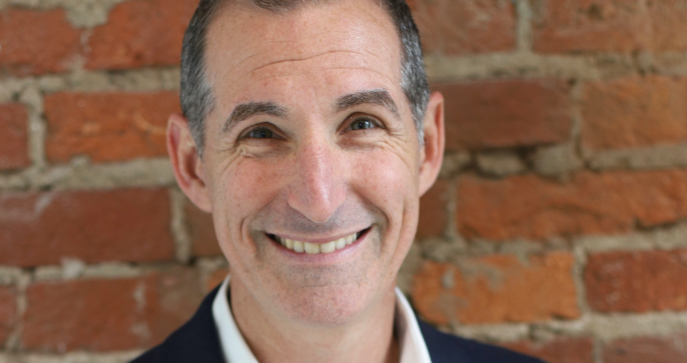
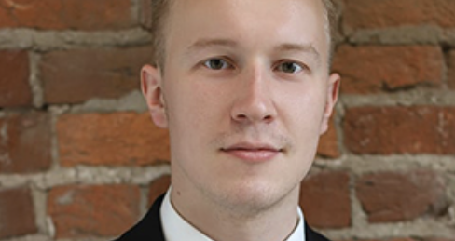
Your COVID-19 Response Team
Example of Response Team
Sidney Abrams
Patty
Hampton
Atokatha
Ashmond
Brew
Jeanell
Freeman
Lisa
Brown Alexander
All-Staff Town Hall COVID-19 Preparation
|
Mark
Fefelov
Your Logo

Slide 5
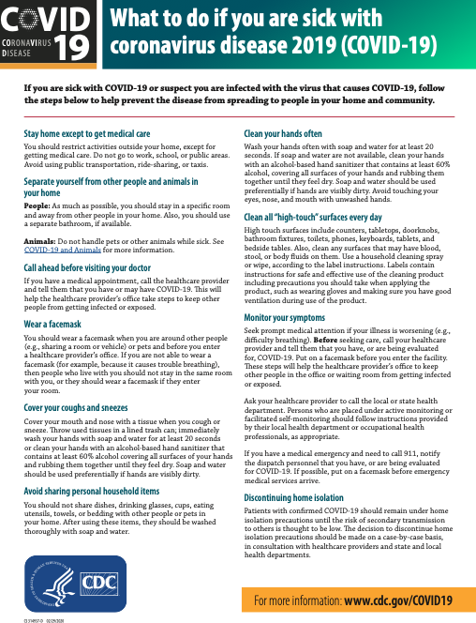
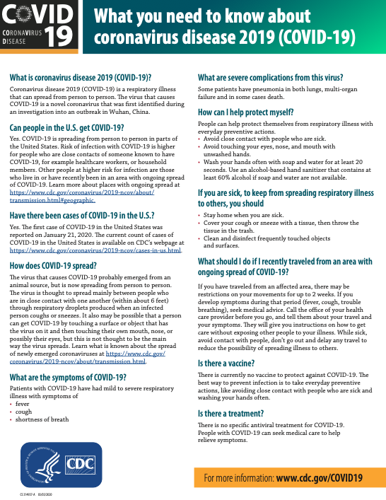
Sample 5 Important Prevention Tips
Keep your safety top of mind!
If you’re sick, stay home.
Self-quarantine for at least 14 days if you think you have been exposed.
Regularly practice good hand hygiene and cough & sneeze etiquette. Routinely wipe down surfaces in your work area (both at ADD ORG NAME and your clients, if applicable).
Notify your Practice Leader if you plan to travel to any of the affected countries in the next 30 days.
Notify your Practice Leader or someone from our COVID-19 Response Team if you think you’ve been exposed to anyone who is infected, or if anyone at one of your on-site clients has been exposed.
Download tools from our new Coronavirus Digital Information Portal
Nonprofithr.com/covid19

Slide 6
Office(s) Precautionary Measures Being Taken
All-Staff Town Hall COVID-19 Preparation
|
YOUR Logo
We have purchased additional supplies of anti-bacterial soaps, hand-sanitizer, tissues, cleaning wipes.
Building Management has been contacted regarding cleaning protocols.
Emergency staff contacts must be provided or updated/verified in ADD SYSTEM NAME by ALL STAFF no later than close of business ADD DATE.
Our staff directory is being updated and will be distributed no later than ADD DATE.
Clients not on ADD e-Payment feature pay are being asked to consider doing so.
NAMES OF OFFICIAL MEDIA TEAM will serve as the firm’s official spokespersons for all matters related to this situation.

Slide 7
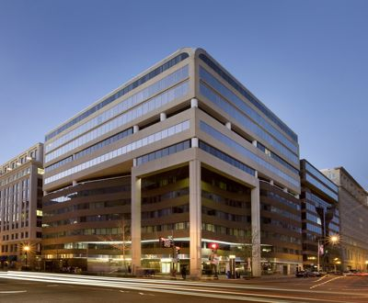
Responses are based on your utmost safety and the continuity of our operations
Sample Scenario 1 - Full Shutdown
Spread of COVID-19 accelerates with multiple transmissions in the DMV region.
District Government declares a health emergency.
ORG NAME’s office(s) close. Staff are notified by email, text, and calls from members of the COVID-19 Response Team.
ORG NAME shifts to fully virtual operations. Events are cancelled. All discretionary staff travel is cancelled until further notice.
All active clients are notified in writing of our decision to operate virtually. Our website is updated, and digital community is notified via email.
Weekly (or more frequent) staff updates from ORG NAME continue via email, text and phone.
Our Planned Response
All-Staff Town Hall COVID-19 Preparation
|
Your Logo

Slide 8
Keep your electronic devices with you to ensure you receive alerts
Sample Scenario 2 - Partial Shutdown
Spread of COVID-19 affects one of our employees or employee of on-site client.
Impacted staff/clients are notified in accordance with HIPAA regulations.
Infected staff seeks medical treatment and self-quarantines for a minimum of 14 days. All scheduled pay and benefits remain in effect.
ORG NAME offices shifts to virtual operations if necessary. Physical space receives deep cleaning and sanitization.
Offices remain operational with increased precautionary measures.
Weekly (or more frequent) staff updates from ORG NAME continue via email, text and phone.
Our Planned Response
All-Staff Town Hall COVID-19 Preparation
|
Your Logo

Slide 9
Sample city - COVID-19 & The District’s Response
Mayor Bowser signed a Mayor’s Order outlining the District’s monitoring, preparation and response. DC Health and the DC Homeland Security and Emergency Management Agency are leading the response.
The current risk remains low in Washington, DC and there are no confirmed coronavirus cases in the city.
DC Health is monitoring the situation closely and participating in national calls with the Centers for Disease Control (CDC).
While the CDC believes the risk to the American public remains low at this time, DC Health is making sure that the city is prepared if a case is identified in the District.
If you are a District resident, are exhibiting symptoms and are concerned that you might have coronavirus, please call DC Health’s hotline at 844-493-2652.
All-Staff Town Hall COVID-19 Preparation
|
Your Logo

Slide 10
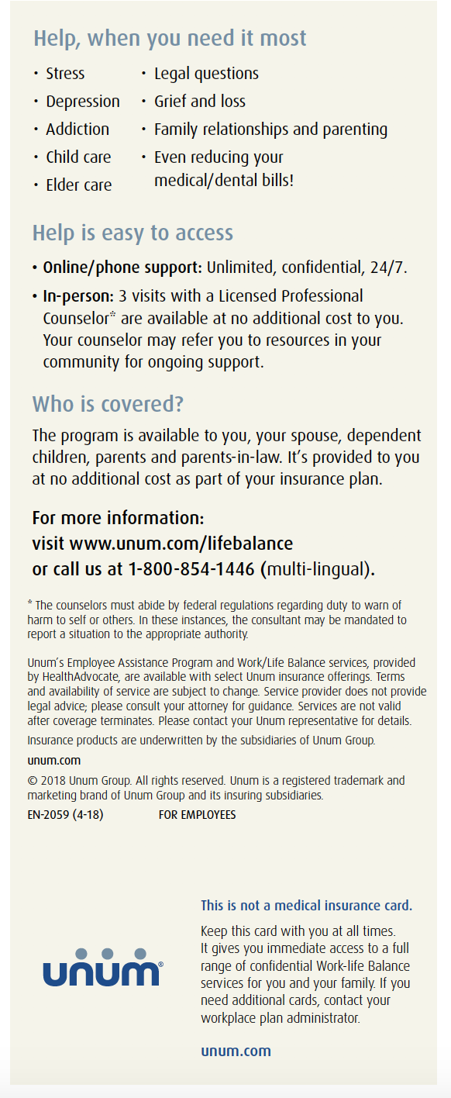
Sample for EAP guidance Need to talk with someone?
Don’t suffer in silence. Lean on our Employee Assistant Program professionals!
Get help for life’s challenges, such as:
Stress
Depression
Addiction
Child care
Elder care
& more
Visit unum.com/lifebalance for details on this employee benefit.
All-Staff Town Hall COVID-19 Preparation
|
Your Logo

Slide 11
Sample List Coronavirus Trustworthy Resources
General Updates:
CDC travel notices
CDC COVID-19 webpage
WHO COVID-19 webpage
Live news updates from the New York Times, CNN and Washington Post
DC’s Metro system has activated its pandemic task force and increased cleanings
State of Maryland Department of Health – Coronavirus Response Alert
Virginia Department of Health – Coronavirus Information Page
All-Staff Town Hall COVID-19 Preparation
|
Your Logo
Nonprofithr.com/covid19

Slide 12
Questions?
Physical Space Issues/Concerns: Add Response team contact(s)
Client Concerns: Add Response team contact(s)
Media Inquiries: Add Response team contact(s)
All-Staff Town Hall COVID-19 Preparation
|
Your Logo

