Slide 1
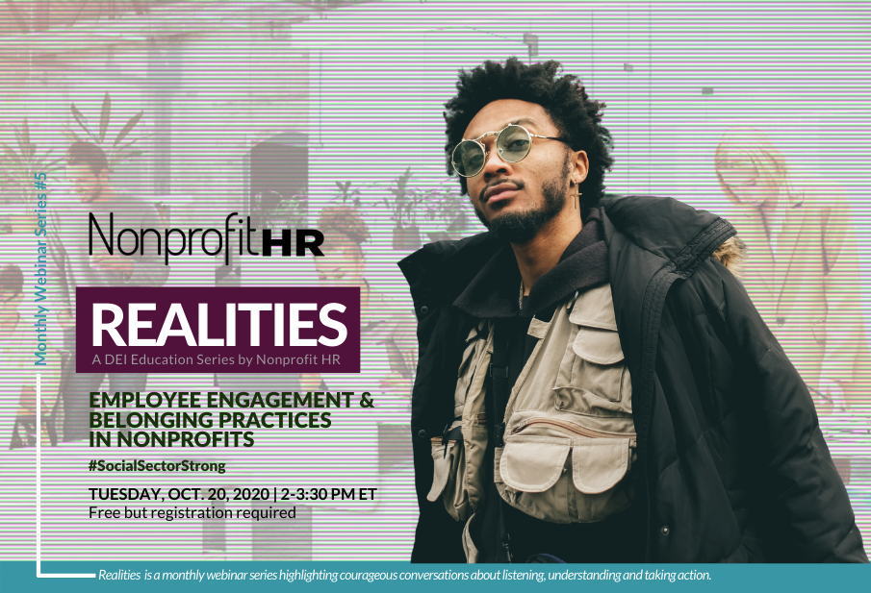
\
nonprofithr.com/events

Slide 2

About Nonprofit HR
Total lifecycle solutions for talent management.
20 years serving the social sector as a trusted advisor and thought-partner.
Hundreds of missions served.
National footprint.
Award-winning and highly credentialed staff.

Slide 3






NOW LIVE!
Playing on all major podcast outlets, including:
Search for The Switch by Nonprofit HR!

Slide 4
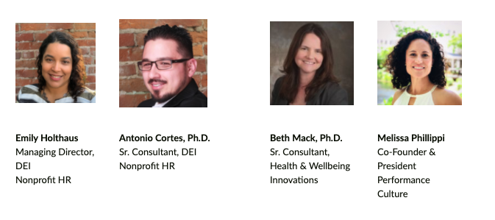
Today’s Presenters

Slide 5


Objectives
How to identify and address employee engagement differences based on employee demographic makeup
New ways that employees may expect to influence, engage and be heard in the workplace
How to create meaningful employee engagement practices aimed at fostering belonging

Slide 6
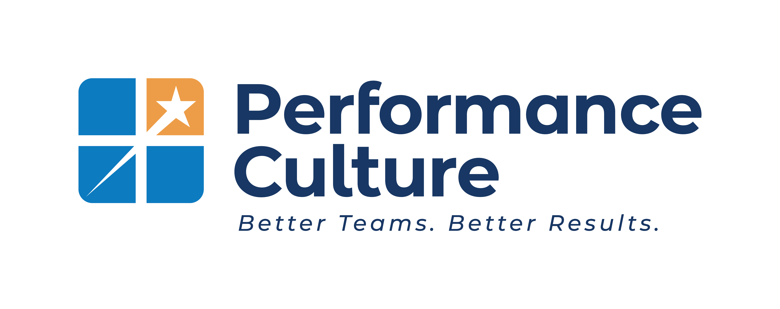












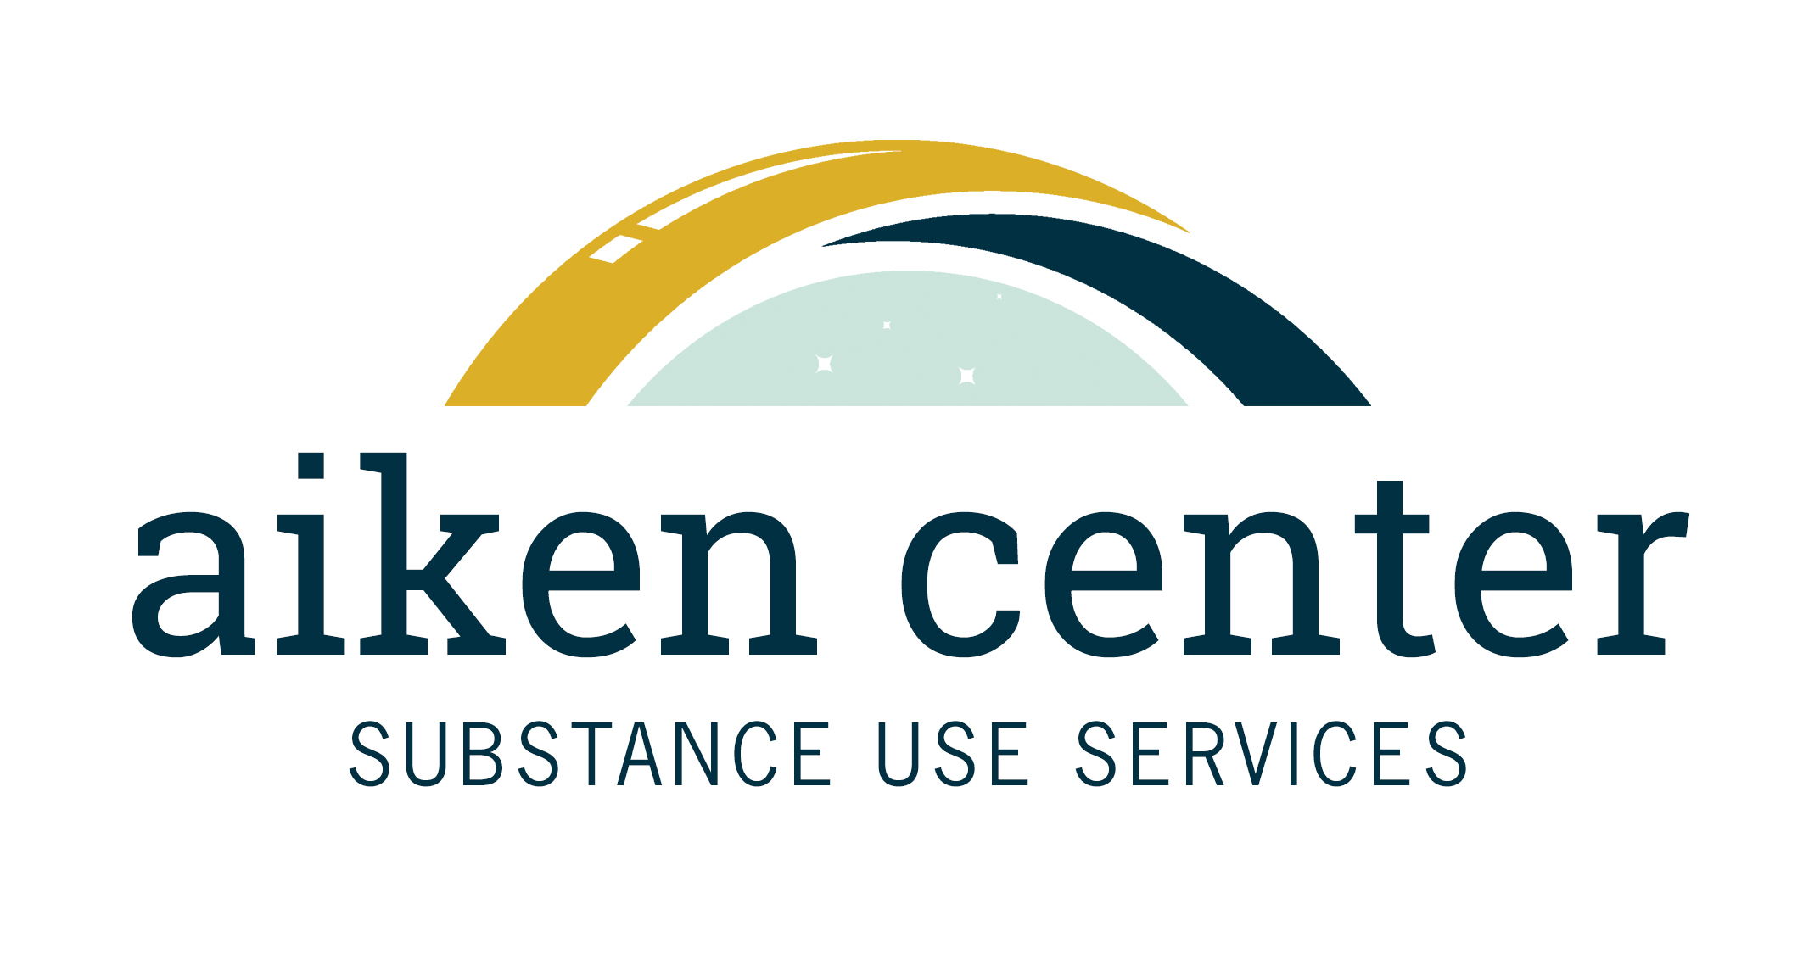




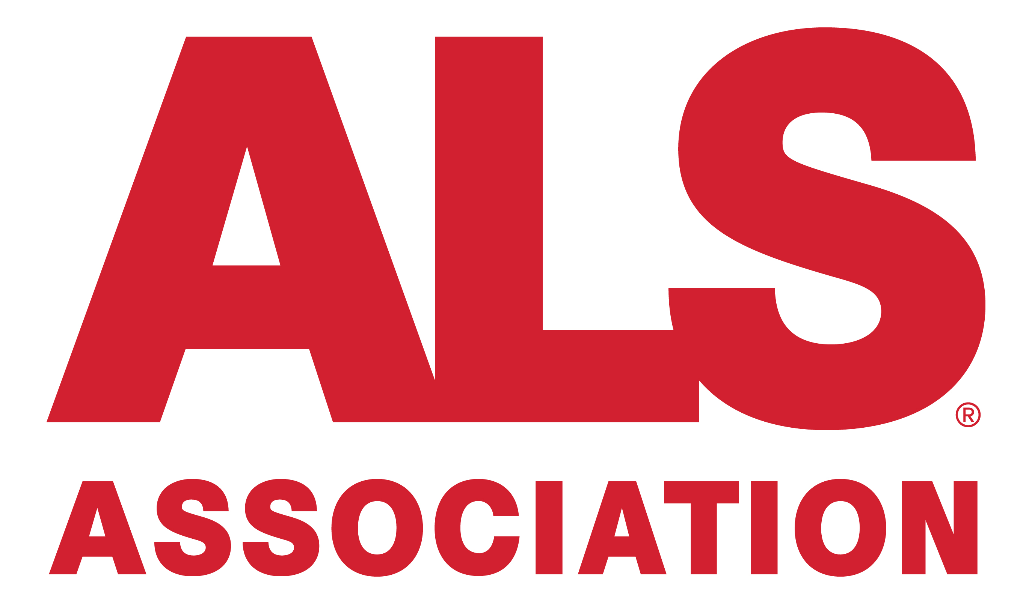


We love helping Nonprofits!

Slide 7

Effective Performance Management Engages and Inspires
INSPIRED EMPLOYEES…
PRODUCTIVITY
Get meaning and inspiration from the company’s mission
Are inspired by the leaders in their company
225%
ENGAGED EMPLOYEES…
Are part of a great team
Are empowered and not micro-managed
Have an opportunity to learn and grow
Make a difference and have an impact
144%
SATISFIED EMPLOYEES…
Have a safe work environment
Have the tools, training, and resources to do their job well
Can get their jobs done efficiently, without excess bureaucracy
Are valued and rewarded fairly
100% vs 77% for
unsatisfied
employees
Source: Pyramid of Employee Needs; Bain & Company 2015 EIU Research (300 Companies)

Slide 8
Performance Management Software that helps you Build Better Teams for Better Results
hello@PerformanceCulture.com
To learn more and request a deeper dive.
PerformanceCulture.com

Slide 9
Engagement & Belonging

Slide 10
EMPLOYEE ENGAGEMENT
“Fully involved, enthusiastic and committed to the team.”
Belonging
“a feeling of connectedness enforced by a culture that you can purposefully create.”

Slide 11


How are you doing with Engaging your Teams?
Notes:
Poll
How do you know?
Continuum of engagement – everyone is on different places – move them.

Slide 12
The Relationship Between Belonging and Engagement
A feeling of belonging at a company has the strongest relationship to engagement
This means that belonging has a high correlation to business outcomes like productivity and retention
Notes:
https://workology.com/how-to-build-belonging-at-work-and-why-it-matters/

Slide 13
Business Case for Engagement
Outperform colleagues by 20% +
(The Conference Board)
Generate 40% more revenue
(Hay Group)
60% fewer sick days
(Gallup)
87% less likely to leave
(CEB)
Return on Assets, Net Margin, Customer Satisfaction and Company Reputation increase as engagement increases
(Independent Experts)
Notes:
The Conference Board is the member-driven think tank that delivers trusted insights for what’s ahead. Our mission is simple: To help leaders navigate the biggest issues impacting business and better serve society.
Hay Group - The firm was started on the premise that maximizing companies’ people management skills would vastly improve their output, both in terms of quality and quantity. Acquired by Korn Ferry in 2015 – a global organization consulting firm.
Gallup - We're a global analytics and advice firm that helps leaders and organizations solve their most pressing problems.
CEB - CEB is a best practice insight and technology company. In partnership with leading organizations around the globe, they develop innovative solutions to drive corporate performance.
Countless professionals agree – for example, Benjamin Schneider, Organizational research consultant and scholar with special expertise in climate, culture and engagement diagnosis claims the last frame.

Slide 14
Current climate

Slide 15

What a difference a year makes
2019 Gallup Poll
High-development cultures are CEO- and board-initiated.
High-development cultures educate managers on new ways of managing – moving from “boss” to “coach”.
High-development cultures practice companywide communication.
High-development cultures hold managers accountable.
2020 Gallup Poll
Societal unrest in the wake of the killing of George Floyd and the resurfacing of diversity and inclusion challenges in the workplace.
Unclear business plans as a result of state-wide shutdowns.
Previously furloughed workers returning to the workforce had slightly lower engagement scores.
Notes:
Presenter Notes:
Gallup tracks employee engagement and according to their 2019 report, engagement was at an all time high. They indicated there were 4 factors driving this
1. High-development cultures are CEO- and board-initiated.
The organization has a well-defined purpose and brand -- why it exists and how it wants to be known. Everyone in the organization understands that employee engagement is a system for achieving unity of purpose and brand. Leaders explicitly connect engagement elements to their business issues. This means making engagement relevant to everyday work rather than an abstract concept.
Top executives initiate the effort. They know that their attitudes, beliefs and behaviors have a powerful cascading effect on their organization's culture. Leaders of great workplaces don't just talk about what they want to see in the management ranks -- they live it.
Leaders map out a course for improvement. They identify where the company is today and where they want it to be in the future.
2. High-development cultures educate managers on new ways of managing -- moving from a culture of "boss" to "coach."
The best organizations have leaders who encourage their teams to solve problems at the local level rather than using top-down commands. They focus their training and development programs on building local managers' and teams' capability to solve issues on their own.
Engagement, performance and training are all aligned. Training is strengths-based and grounded in the 12 elements of engagement. Managers learn how to identify the strengths of team members and how to use and build strengths to achieve better outcomes.
Training is tailored to managers' capacity. Managers with high performance and high team engagement receive more advanced curricula than those with lower performance and lower team engagement.
3. High-development cultures practice companywide communication.
The best organizations have exceptional CHROs who build systems that teach managers how to develop employees in line with their innate tendencies.
These organizations have a designated "champions network" that communicates, collects best practices and answers questions.
The ongoing collection of best-practice examples creates a vivid picture of what highly engaged teams look like.
4. High-development cultures hold managers accountable.
The companies in our study with the highest engagement levels see employee recognition as a means to develop and stretch employees to new levels of success. Recognition of outstanding team leaders sends a strong message about what the company values.
Tolerance of mediocrity does not exist in the best organizations. They define high team performance based on a combination of metrics such as productivity, retention rates, customer service and employee engagement. It is clear to those managers that their job is to engage their teams. The best companies have consequences for ongoing patterns of team disengagement -- most importantly, changing managers.
The best organizations believe that not everyone should be a manager, and they create high-value career paths for individual contributor roles. No one should feel like their progress depends on being promoted to manager.
The best organizations know there is no meaningful mission or purpose in the absence of clear expectations, ongoing conversations and accountability.
Sources:
https://www.gallup.com/workplace/284180/factors-driving-record-high-employee-engagement.aspx
https://www.anserj.ca/index.php/cjnser/article/view/372/245
https://www.gallup.com/workplace/313313/historic-drop-employee-engagement-follows-record-rise.aspx

Slide 16
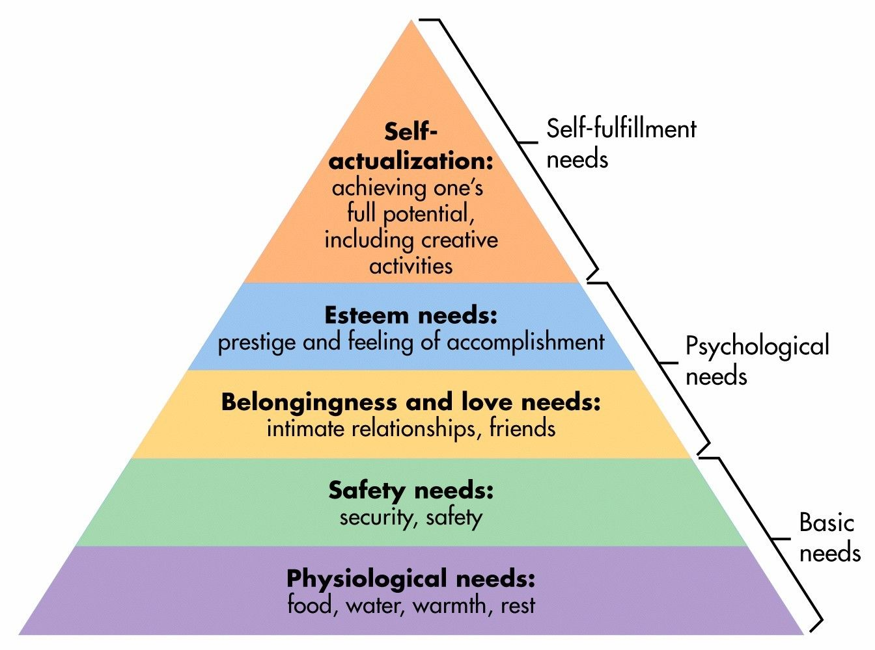
Relevance of belonging
Maslow’s Hierarchy of Needs
“A deep sense of love and belonging is an irreducible need of all people. We are biologically, cognitively, physically, and spiritually wired to love, to be loved, and to belong. When those needs are not met, we don’t function as we were meant to. We break. We fall apart. We numb. We ache. We hurt others. We get sick.”
~ Brene Brown ~
Notes:
Sources:
Perry, R. (2018). Belonging at work: Everyday actions you can take to cultivate an inclusive organization. RPC Academy Press.
Maslow’s Hierarchy: https://www.simplypsychology.org/maslow.html

Slide 17
Well-being case

Slide 18
Health and wellbeing measures
“Connection is the currency of wellness.” ~John Travis, MD, MPH~
DSSI:
Amount of time spent talking with other people at work or school
Do family and friends understand you?
Does family or friends ever help in any of the following ways? (response yes/no)
- Listen to your problems.
- Give you advice on dealing with life’s problems?
UCLA Loneliness Index:
I feel as if nobody really understands me.
My interests and ideas are not shared by those around me.
No one really knows me well.
I feel shut out and excluded by others.
People are around me but not with me.
Cantril Ladder:
What area on the ladder represents the best possible life for you (at this time)?
On which step do you think you stand about 5 years from now?
Thriving, Struggling, Suffering
Notes:
Presenter Notes:
Social Isolation and Health
Gallup Wellbeing
World Happiness Report
https://www.ncbi.nlm.nih.gov/pmc/articles/PMC5778415/#:~:text=For%2050%20years%20the%20Cantril,for%20either%20respondent%20or%20interviewer.

Slide 19



Wellbeing measures related to engagement
↓ 64% in safety incidents (accidents)
↓ 58% in patient safety incidents (mortality and falls)
↑ 66% in wellbeing (thriving employees)
Notes:
Presenter Notes:
This is taken from Gallup’s most recent 2020 survey related to employee engagement and performance. When comparing top-quartile with bottom-quartile engagement, Gallup found that business units and teams resulted in median percent differences of…
Fewer negative outcomes -
A 64% difference in safety incident (accidents)
A 58% difference in patient safety incidents (mortality and falls) (obviously healthcare organization-specific)
And greater organizational success –
A 66% difference in wellbeing (thriving employees)
Sources:
Gallup. Employee Engagement and Performance: Latest Insights From the World’s Largest Study

Slide 20
Diversity, equity and inclusion overlay

Slide 21
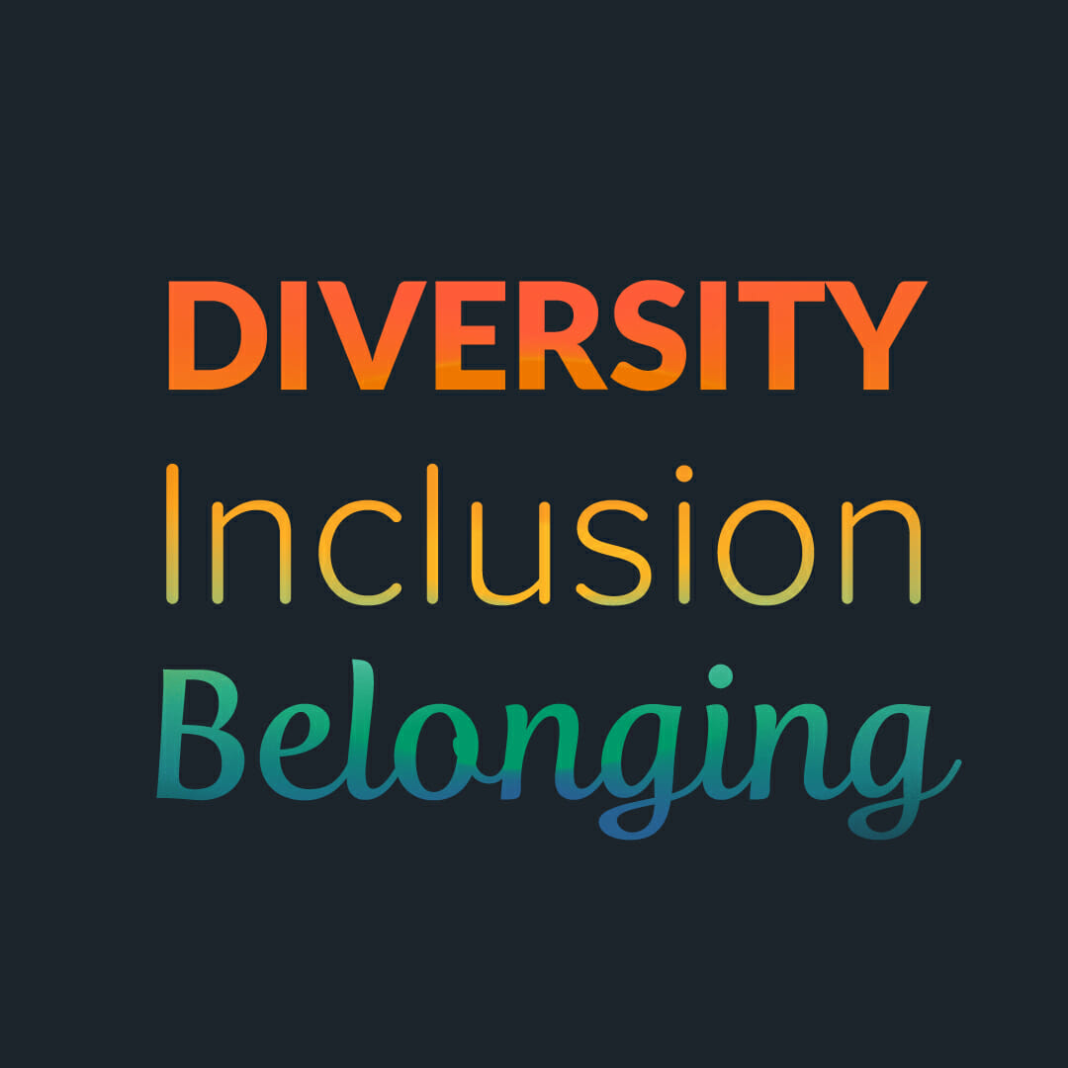
Considerations Related to Cultural Diversity
Diversity Equity and Inclusion (DEI) precede Belonging
Trust and mutual respect for diversity of opinions and perspectives is the foundation for an engaged and culturally diverse workplace.
When an organization has a strong reputation as a leader in promoting cultural diversity, corporate social responsibility practices, and walks the talk of DEI, employees feel a sense of safety. - Diversity Officer Magazine
The correlation between belonging and engagement is higher for historically underrepresented groups.
Notes:
https://diversityofficermagazine.com/talent-management-2/cultural-diversity-inclusive-workplace-engagement-drivers/

Slide 22
The Intergenerational Workforce
The Silent Generation (born 1928-1945)
Key Considerations: Tend to be civic-minded, good team players, place emphasis on process, mixed proficiency with new technology and they value being useful and feeling needed.
Strategies: Make sure they have ample access to training, as competency is a key engagement driver.
Baby Boomers (born 1946-1964)
Key Considerations: Bring an enormous breadth of experience to the table, may have evolving personal needs.
Strategies: Increased role clarity and understanding of how an organization utilizes their skills, be aware of their unique challenges.
Generation X (born 1965 – 1980)
Key Considerations: See themselves as next in line to take the reins, but grow impatient as older workers stay on in the workplace.
Strategies: Provide opportunities for them to continue learning and growing, training and development can be engagement drivers.
Millennials (born 1981 – 1996)
Key Considerations: Often prioritize making a visible difference in the world, yearn for purpose and align with organizational values.
Strategies: Providing corporate philanthropy opportunities and career-pathing activities to keep them excited about their work.
Generation Z (born 1997 or later)
Key Considerations: Most diverse and educated generation, may struggle with role clarity and building professional relationships.
Strategies: Setting clear expectations about their roles, infusing onboarding process with social interaction, and matching with mentors.
Notes:
https://emplify.com/blog/employee-engagement-by-generation/

Slide 23
Leadership behaviors that are essential for shaping culture
Assessing the levels of Belonging and Engagement in your organization
Articulating expectations about behaviors expected to these concepts
Role Modeling behaviors for others
Reinforcing
a culture that allows people to be their best
Resources: Measuring Belonging, Simple Methods to Foster Belonging & Engagement, Designing Space to Support Community

Slide 24
Fostering Belonging and Engagement
Belonging
Engagement
Focus on Purpose: Communicate the intersection of your organization’s purpose with your employee’s contributions.
Be Intentional About Inclusion: Deliberately and with calculated efforts to bring your staff’s voices to the table and seek to learn about them.
Embed it Into the Organizational Culture: Creating memorable experiences, personalized interactions, tailored motivators, fast feedback.
Mitigate Burnout: Burnout blocks the opportunity for engagement to occur, check in with our staff to see how they are managing, identify ways to shift workloads.
Build Team Trust: Building trust takes time, providing informal opportunities for people to get to know each other can function as a foundation for trust.
Celebrate Contributions: Create a culture that celebrates your employees’ contributions for advancing organizational goals.

Slide 25
Inspiration

Slide 26
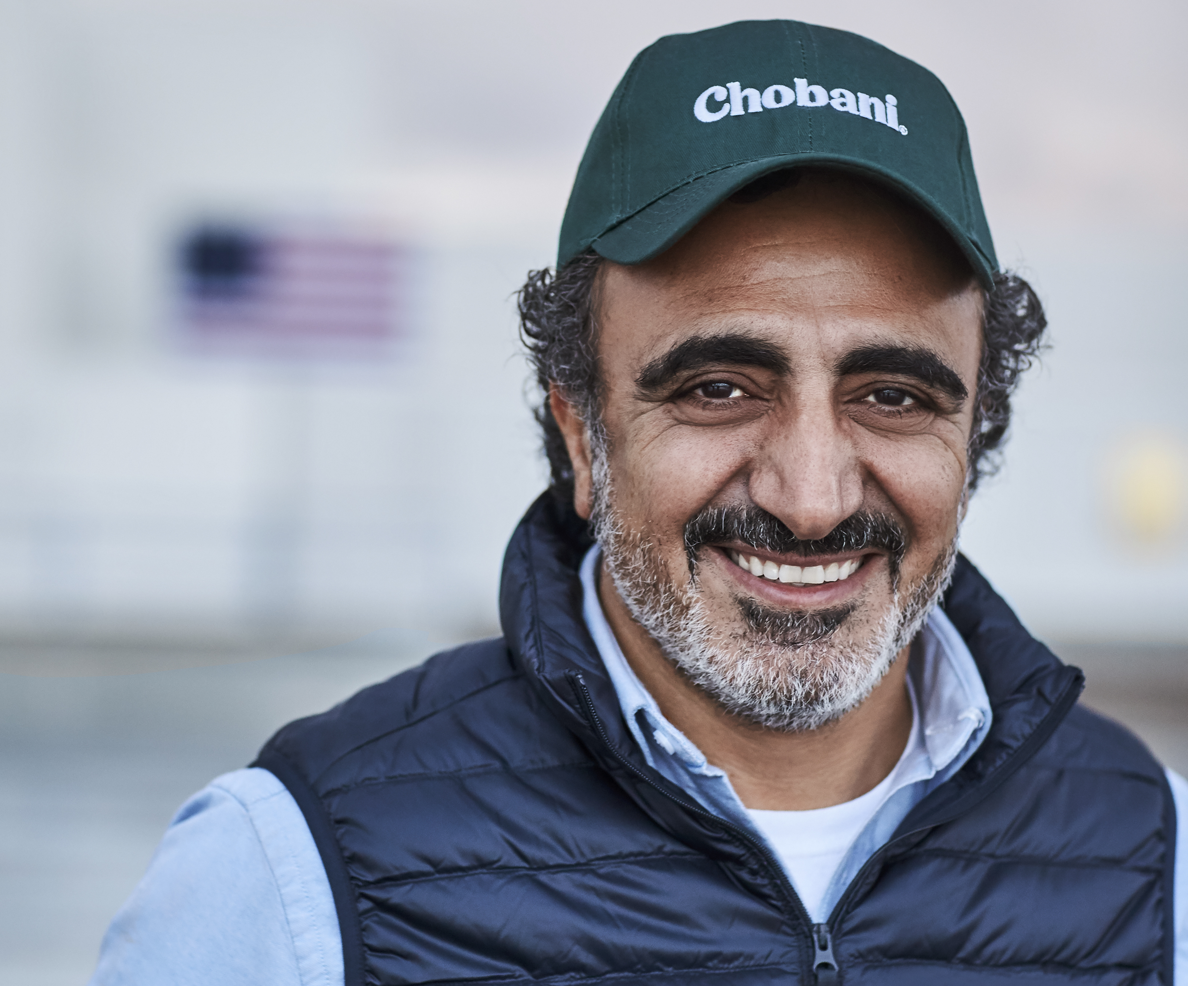
Case Study
Hamdi Ulukaya, CEO Chobani
Hamdi's TED Talk
Notes:
Presenter Notes:
So, who is doing this well? One example is Hamdi Ulukaya, the CEO of Chobani. Hamdi has been lauded as being an innovator not just in the space of food production but in the area of employee engagement.
Some of the secrets of his success are to not lead from a distance. “Being shoulder-to-shoulder and seeing people, working with them, understanding their conditions, and understanding how they feel about the company, how they feel about the work, how the communities react to it is also very much tied to the success of the business,”. He also believes in investing in his employees. In his TED talk, Hamdi, urges companies to “adopt the “anti-CEO playbook,” starting with practicing gratitude, noting that “business should take care of their employees first. This notion of doing things by your employees — and making sure they have the conditions for themselves and for their families and for their communities — it’s not an expense. It’s an investment in your own company, in your own people, in your own dream. Every time you invest in your people, the return is 100 times greater than the expenses,” he says. He also says to include the community. For Hamdi, he fosters this sense of community both at work and within the local community, in particular the communities in which Chobani operates.
Of course, these were written / recorded before the pandemic, BUT during and throughout he has shown no signs of slowing. Chobani has committed to shipping out food products to support individuals and communities impacted by COVID to the tune of one truckload of fresh product daily to foodbanks and intake centers. He also has founded the Tent Partnership (tent.org) and has brought on other agencies to partner with him. The organization encourages businesses to help integrate refugees economically into their new communities as employees, entrepreneurs and consumers. The foundation’s business case is to strengthen the workforce, drive brand loyalty and increase employee engagement.
Sources:
https://thriveglobal.com/stories/chobabi-ceo-hamdi-ulukaya-happiness-employees-community/
https://www.ted.com/talks/hamdi_ulukaya_the_anti_ceo_playbook?utm_campaign=tedspread&utm_medium=referral&utm_source=tedcomshare
https://www.dairyreporter.com/Article/2020/04/27/Positive-contributions-from-dairy-continue
https://www.prnewswire.com/news-releases/global-companies-demonstrate-commitment-to-include-refugees-in-post-covid-recovery-by-joining-the-tent-partnership-for-refugees-301146291

Slide 27
Let’s Talk
Q&A

Slide 28

Contact Us
Emily Holthaus, Managing Director, DEI, Nonprofit HR
eholthaus@nonprofithr.com
Antonio Cortes, PhD, Senior Consultant, DEI, Nonprofit HR
acortes@nonprofithr.com
Beth Taylor Mack, PhD, Senior Consultant, Heath & Wellbeing Innovations
bethmack@ptd.net
Melissa Phillippi, Co-Founder and President, Performance Culture
hello@performanceculture.com
nonprofithr.com
© Nonprofit HR

